Slide 2
Dragonfly Introduction
Allen Sun, alibaba
Zuozheng Hu, alibaba

Slide 3

Status
Roadmap
01
03
Agenda
02
04
History
Adoption

Slide 4
PART ONE
History
01

Slide 5
What and Why
P2P based, high reliable, image distribution
system at large scale
Bottleneck in pulling images in DCs of
Alibaba Group

Slide 6
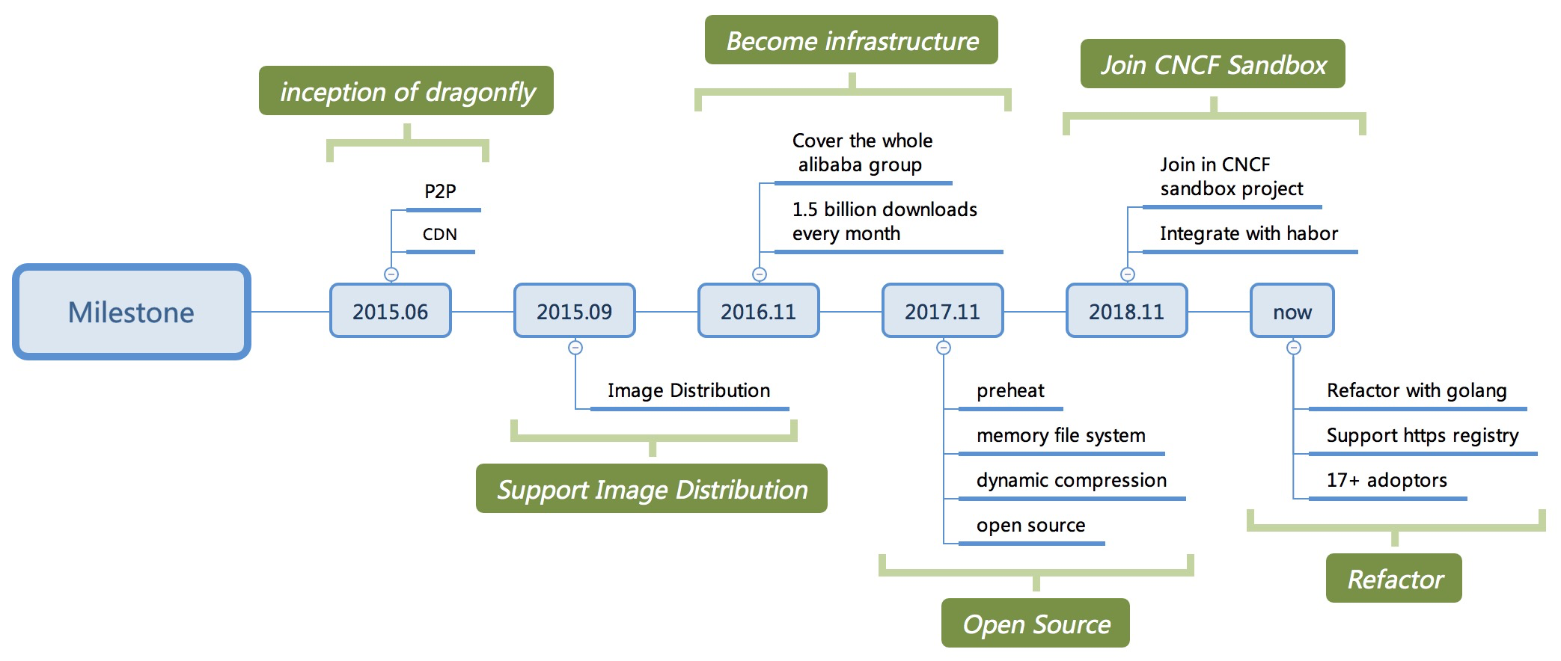
Milestone

Slide 7
PART TWO
Status
02
Notes:
Hello, everyone, I am the founder of dragonfly, leading the design and part of the development of dragonfly. Next, let me introduce the dragonfly’s current situation
Dragonfly has been opened source for 18 months and has joined the CNCF Sandbox project.So what is its current situation?
Okay，Since dragonfly is a image distribution system，there is no doubt that distribution efficiency is its first element. So let's start with a performance comparison

Slide 8
Native vs Dragonfly
Testing conditions:
Server: 2 VMs(24C64G, SSD,
1000Mb/s)
Client: 200 VMs(4C8G, 100Mb/s)
Conclusion:
Dragonfly is more smoothly than native
With the expansion of the scale, dragonfly’s advantage becomes more and more obvious
Notes:
On the left is the testing conditions，There are two VMs running server, which is SuperNode mentioned later. Server configuration is 24core 64GB, ssd, gigabit ethernet. There are 200 virtual machines as clients, which are configured as 4core 8GB and hundred megabit ethernet. The image size tested is 750MB
On the right is performance comparison data，X-axis is the number of parallel downloads, Y-axis is the average download time，The orange curve represents the average time spent using dragonfly to download image. It can be clearly seen that when using dragonfly to download images, with the expansion of download scale, download time is still very stable, basically maintained at about 80 seconds. After calculation, the whole download process makes full use of the client's network bandwidth, about 90% bandwidth. It also shows that dragonfly's P2P effect is very remarkable. Ok, let’s see he green curve, it indicates the download time required with the native mode, that is, to download the image directly from Registry. It is obvious that download time increases exponentially as the scale increases. At the same time, when the scale reaches a certain level, registry will go down. which leads to the failure of download, but using dragonfly doesn't have this problem. Because only the superNode downloads image just once from registry to make the initial seed for the client to use. It can also provide CDN cache for subsequent downloads.
From the above data, we have good reason to believe that dragonfly can completely solve the problems about efficiency and stability at large-scale image distribution. At the same time, the use of dragonfly will not bring any intrusive modification to the container engine、image registry、 kubernetes and so on. Of course, dragonfly also supports integration with related systems in order to generate more "chemical reactions" and further enhance its distribution capability.
Okay, just now we've learned that dragonfly has a very powerful capability to distribute image, which can completely solve the image distribution problem in the production environment. So what is the status of dragonfly in the open source community?

Slide 9
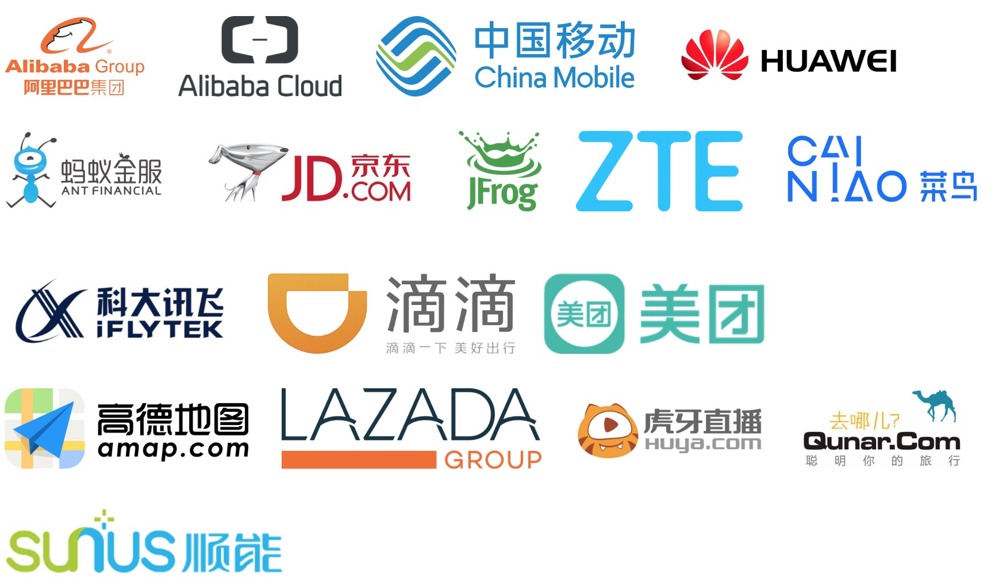
Community Situation
Stars: 3400+
Adoptors: 50+
Maintainers: 6
Outside: 1 ebay, 1 meitu
Internal: 4 alibaba group
Contributors: 32
Discussion Group:
DingTalk: 23304666
Gitter: please refer to Github
Notes:
At present, more than 50 companies have become Adoptor of dragonfly, including China Mobile、Huawei、DiDi、Lazada、JFrog、IFlyTek and so on
Dragonfly currently have more than 3400 Stars on Github, as well as six Maintainers and 32 Contributors.
In addition to Github, we also have a variety of community discussion channels, such as Gitter, DingTalk and WeChat.
Dragonfly is currently doing refactor using Golang and is planning many new features. We warmly welcome interested people to join us to make dragonfly stronger and stronger.
We have just introduced the current situation of dragonfly development in the community. Next, let's focus on the main principles and core architecture of dragonfly. I believe you will be more interested in this aspect.

Slide 10
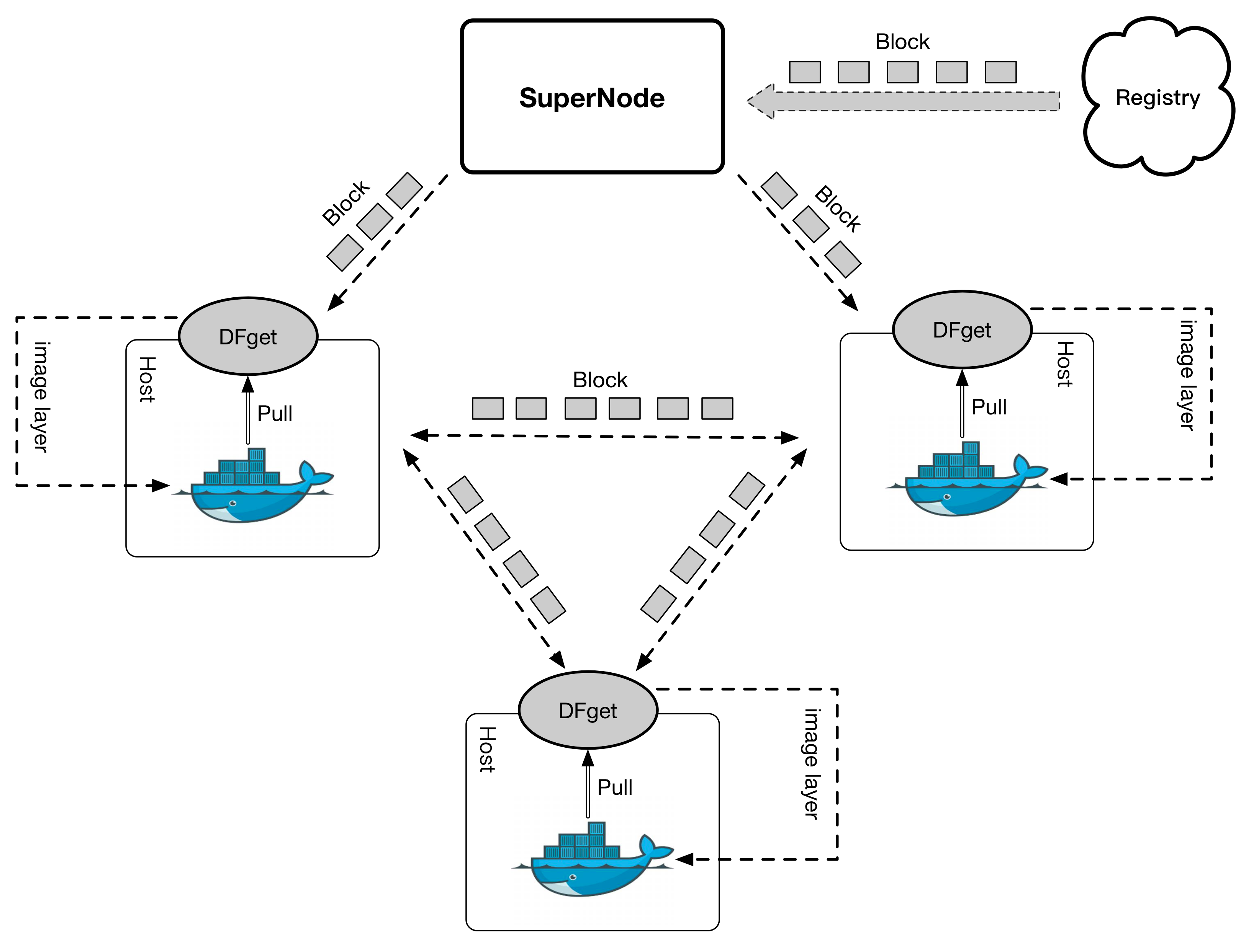
P2P Mechanism
Notes:
First, let's briefly analyze the process of image distribution using dragonfly P2P mechanism.
dragonfly client is installed on each Node, which is configured as a download proxy for the container engine
When the container engine executes the PULL Image command, the download request enters the proxy, which is the dragonfly client. Then the dragonfly client attains the download url of a image layer and requestes the supernode with that url and some other information.
When the super node receives the registration request from the client, it will add the client to a certain P2P network, which is composed of multiple clients downloading the same image layer.
At the same time, the supernode will synchronize the image from registry at most once. In the process of synchronization, every block downloaded will generate a block seed in the local storage, which can be immediately spread between multiple clients.
When the client finishes all the pieces of a layer, the container engine will copy the layer from the client to the local image store via local http request. We are also planning to further accelerate the download by streaming mode to avoid disk IO and copying on the client side.
The download of each layer of the image as shown above, and when all the layers needed for the image are downloaded, then the Pull command is executed successfully.
If there are other nodes that will need to download the same image afterwards, because the previous one has been cached by CDN, the seed in cache can be directly used for block propagation, without synchronizing the image from registry and making the seed again, so the download rate will be faster than the previous one.
Okay, I believe everyone already knows more about dragonfly. Finally, I'd like to introduce the core architecture of dragonfly, that is, SuperNode architecture

Slide 11
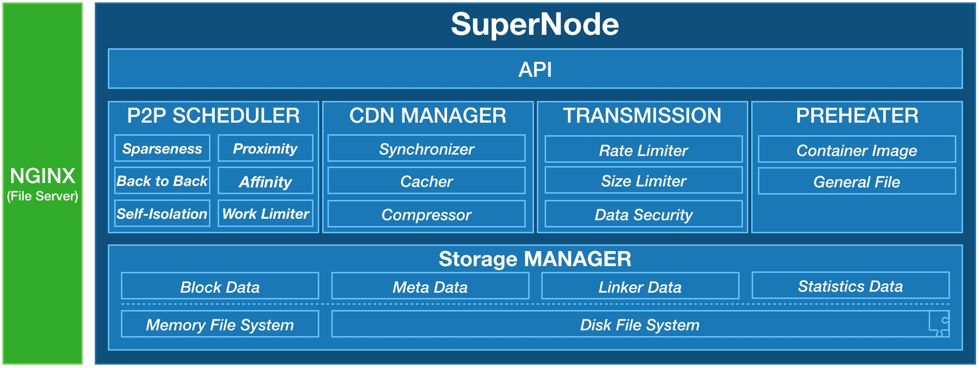
SuperNode ARC
Dragonfly dose
its best to speed up download
and save traffic!
Notes:
By introducing the SuperNode's architecture, you will understand how dragonfly do its best to improve the image download rate and save network traffic.
SuperNode is mainly composed of five modules, including P2P scheduler, CDN management, transmission controller, data preheater and storage management.
…… balabala
Okay, here's the status of dragonfly. Next, Let Allen continues with the following introduction

Slide 12
PART THREE
Adoption
03

Slide 13
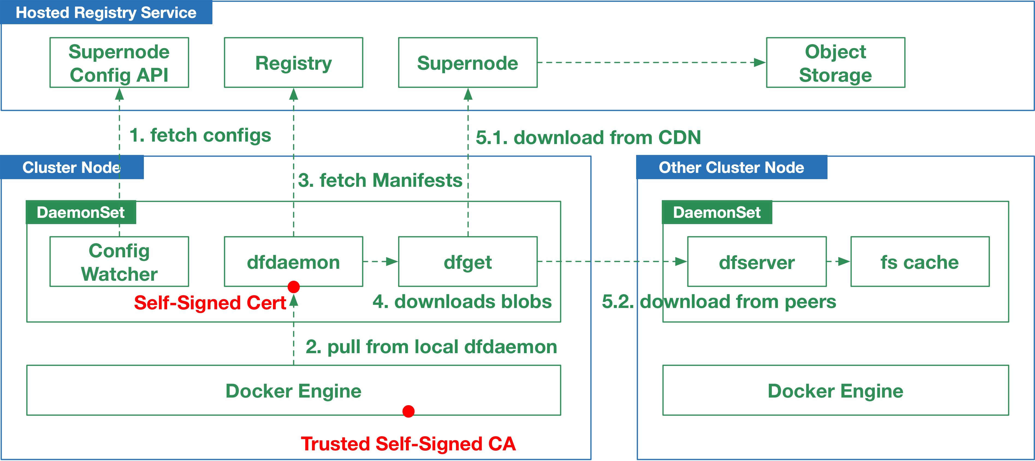
Practice in Alibaba Cloud
ACR(Alibaba Container Registry Service) provides two registry domains, one for normal cases, the other is for P2P distributed pulls, which always points to localhost.
ACR’s P2P image distribution asks users to deploy a DaemonSet in their Kubernetes cluster, and copy a Self-Signed CA to Docker’s configuration path. After this, every node will have a pod running as a registry proxy, then Docker can pull new images using the P2P domain, without any interruption or restart of any containers.

Slide 14
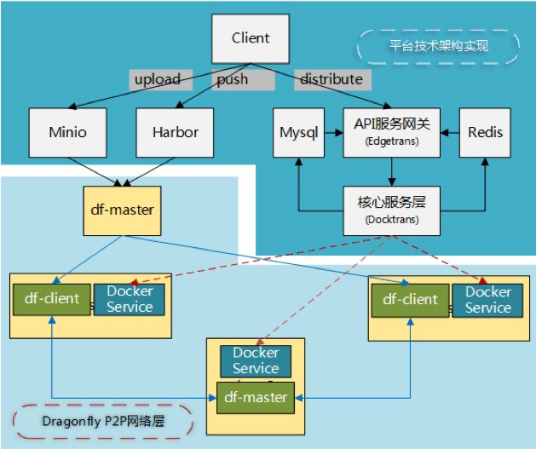
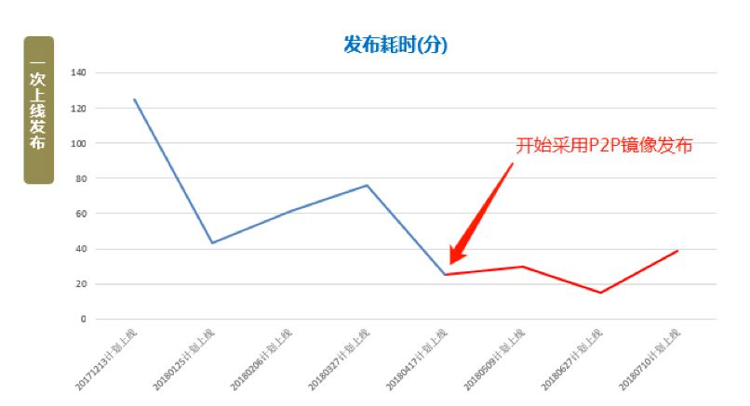

Practice in ZJ Mobile
DCOS ARC
API Gateway
Start to use dragonfly
Kernel service
Dragonfly P2P Overlay

Slide 15
PART FOUR
Roadmap
04

Slide 16
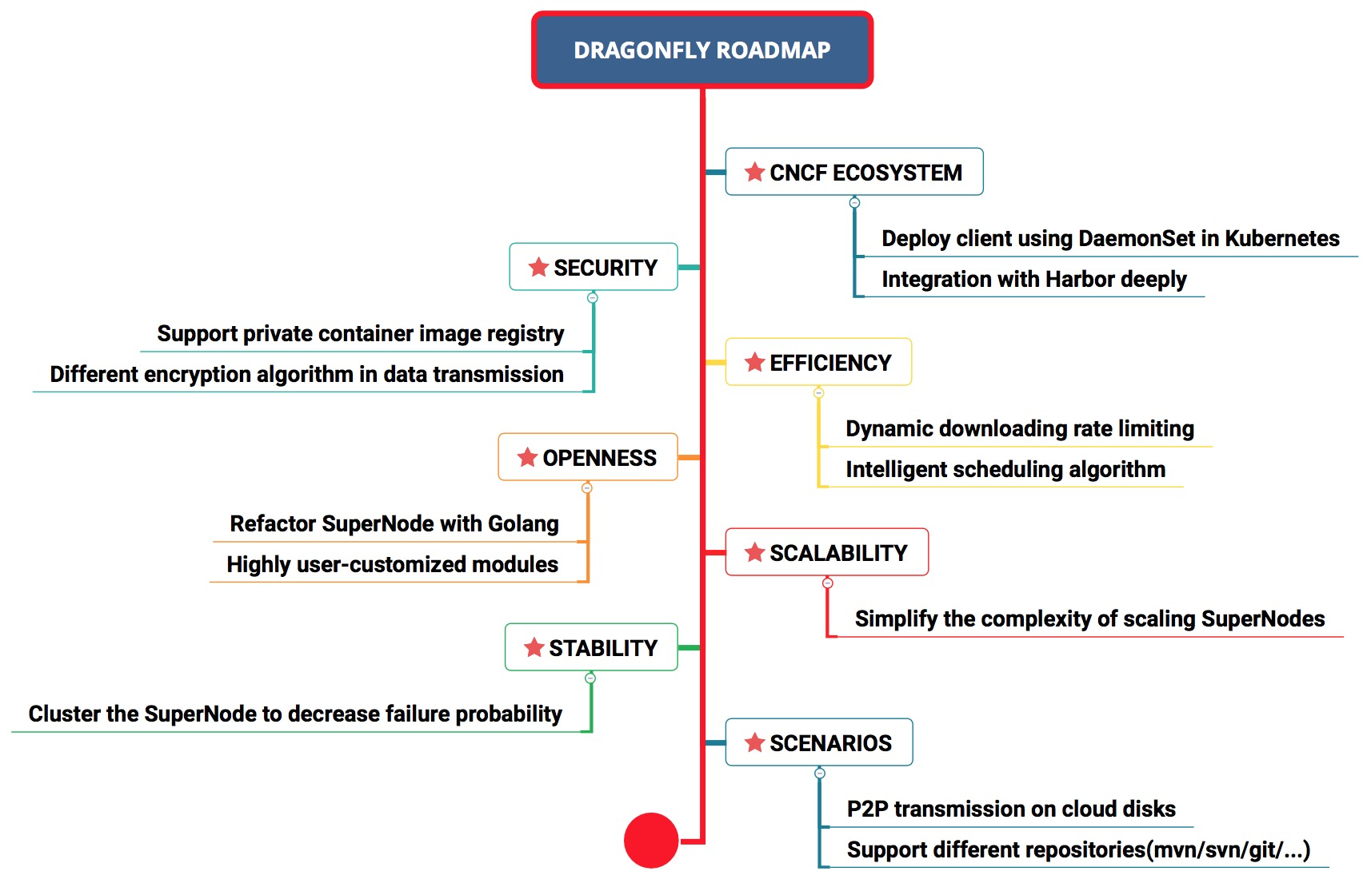
Roadmap

Slide 17
Thanks

